Slide 1

Review
Major Project Winter Semester-2025-26
Department of Electronics and Communication Engineering
Title: BORDER SECURITY REIMAGINED AI POWER SMART SURVELLENCE AND ALERT SYSTEM WITH IOT
Domain: SP DOMAIN
Date:08/05/2026
Project Team Members
VTU23067 (N.DEVA RAJU)
VTU23810(CH.PUNEETH BABU)
VTU23028(G.SRIKANTH REDDY)
Supervisor: DR.DASARI NAGA VINOD
DESIGNTION:ASSISTANT PROFESSOR

Slide 2
Content
Abstract with SDG
Introduction and motivation
Literature survey
Objective
Proposed Methodology/Algorithm/Model
Design/Implementation
Results and Discussion
Conclusion with Justification for SDG alignment
References

Slide 3
Abstract with SDG
This Abstract addresses the growing need for reliable surveillance systems in sensitive border regions such as the Line of Control (LoC), aligning with SDG 16: Peace, Justice and Strong Institutions. We propose a Smart Intrusion Detection Entity (SIDE) system based on the YOLO (You Only Look Once) deep learning framework, integrated with IoT devices such as inductive sensors and web cameras. The system processes real-time video data through preprocessing and feature extraction to distinguish intruders from non-threatening entities. Upon detection, instant alerts are transmitted to a centralized defense control unit via cloud platforms. A customized training strategy is employed to improve robustness under varying environmental conditions. The proposed approach ensures fast, accurate, and efficient intrusion detection, enhancing border surveillance and supporting timely security responses

Slide 4
Introduction and motivation
Introduction:
Border security is a critical component of national safety, especially in high-risk and geographically sensitive regions. Traditional surveillance methods, which rely heavily on manual monitoring and static camera systems, often face limitations such as delayed response, human error, and inability to operate efficiently in harsh environmental conditions. With increasing security challenges and unpredictable intrusion patterns, there is a growing demand for intelligent, automated, and real-time monitoring solutions.

Slide 5
.
Motivation:
The primary motivation for this work arises from the need to overcome the limitations of conventional border security systems. Delayed threat detection and dependence on human surveillance can lead to critical security lapses in sensitive border zones. Additionally, challenging terrains and extreme weather conditions further reduce the effectiveness of traditional systems.

Slide 6
Literature survey
Sl No | Authors | Title | Journal Details with Year | Study | Inference
1 | Bedi.G | Review of internet of things in electric power and energy system | Engineering and science of technology journel,5 (2018) | Electric power and electric systems | the Iot is uded to measure the electric power and energy systms
2 | Wei,j,chen.k | Multiflier fog computing with large scale iot data analysis for smart cities | IEEE internet of things journel5(2) | In this computing the iot is used for analysis of fog in majior city | In the city the morning fog can be reduced sucessfully
3 | M.metis.V | Intelligent iot based automated irrigation system | International journel of Applied engineering(2017) | Irrigation system is advanced | By using iot system the irrigation system is used an advance system
4 | P.K and Babu ,R | AN evolutionary secure energy efficient routing protocol | International journel of intelligient engineeringand system(2017) | Evolution of secure energy | The secure source of energy is secure in this protocol in iot

Slide 7
OBJECTIVE
The objective of the proposed “Border Security Reimagined: AI-Powered Smart Surveillance and Alert System with IoT” is to develop an intelligent and automated surveillance framework that enhances the efficiency and reliability of border security systems. The system aims to utilize deep learning techniques, particularly YOLO-based object detection, to accurately identify and classify intrusions in real time. It also focuses on integrating IoT devices such as cameras and sensors to enable continuous monitoring of border areas

Slide 8
Proposed Methodology
Requirement Analysis
System Design
Hardware Deployment
Data Collection
Smart Alert System
Monitoring Dashboard
Testing and Validation

Slide 9
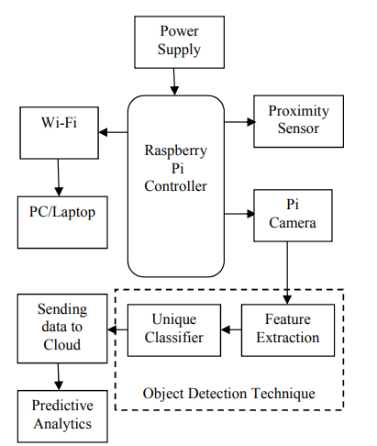
Block Diagram

Slide 10
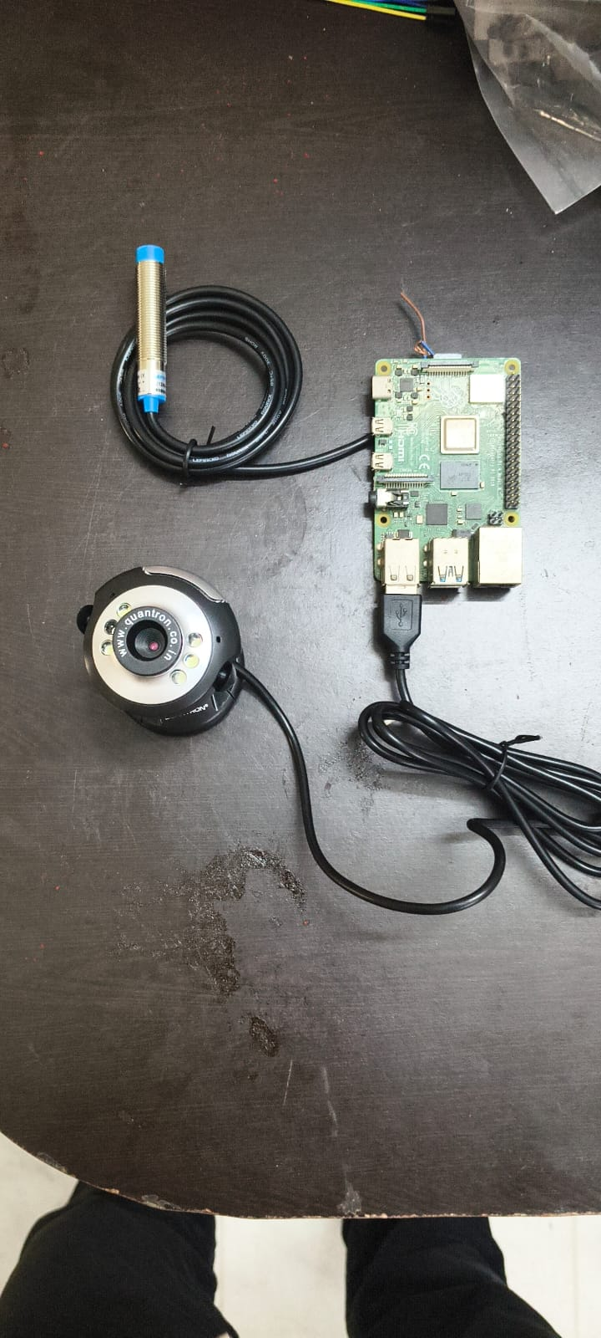
Design/Implementation

Slide 11
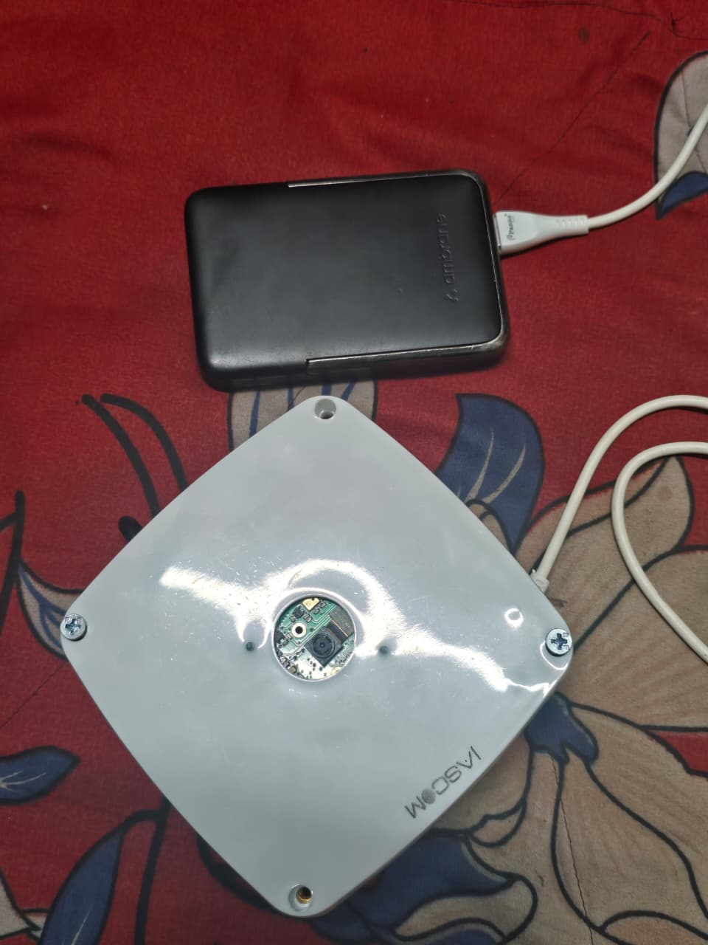
Design/Implementation

Slide 12
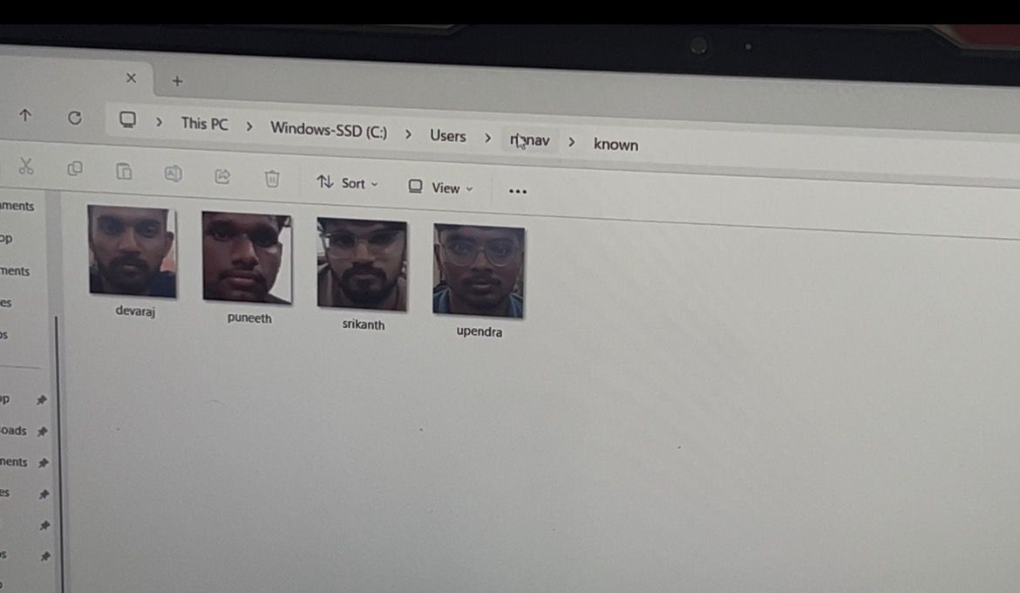
Design/Implementation

Slide 13
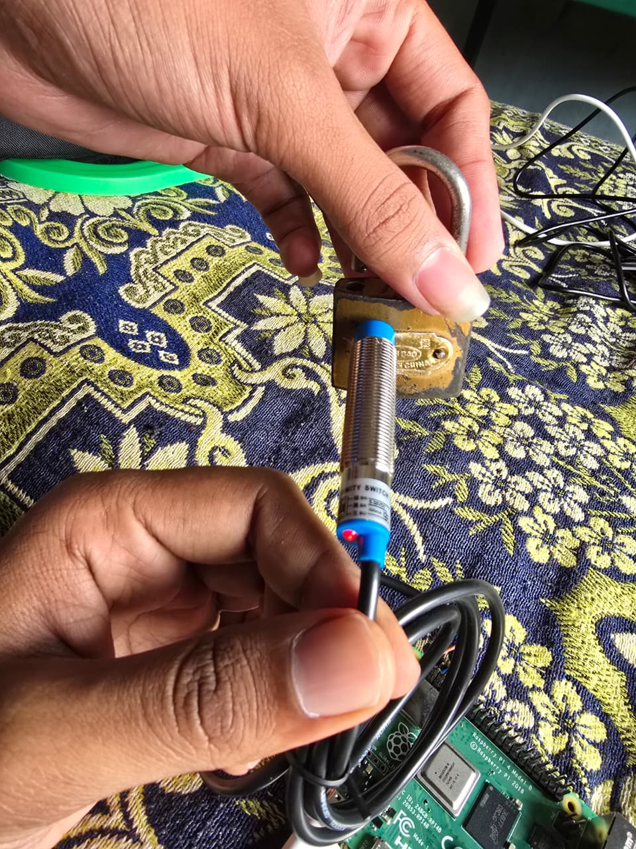
Results and Discussion

Slide 14
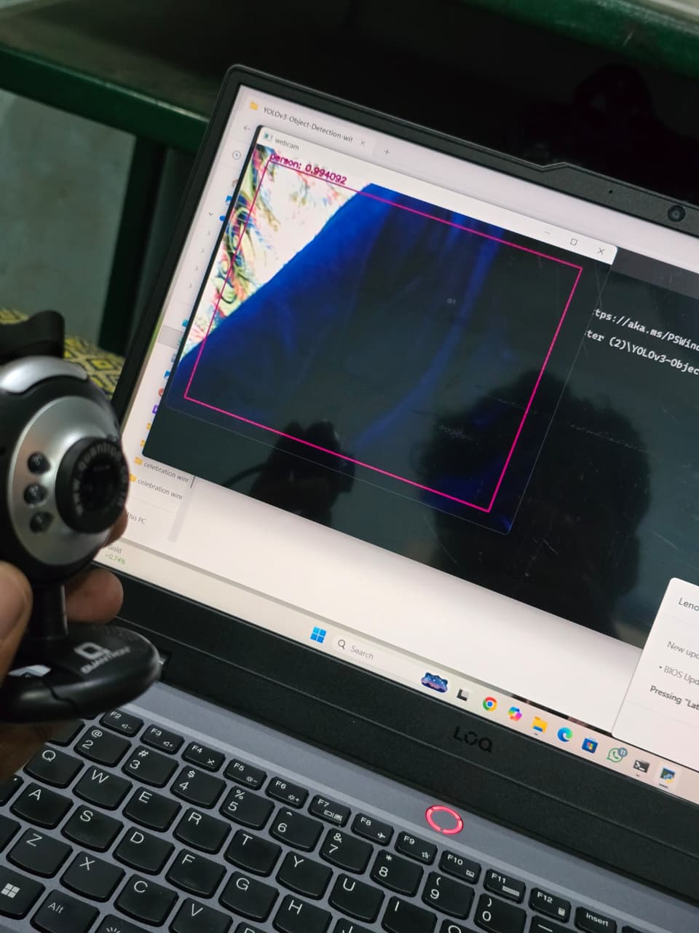
Results and Discussion

Slide 15
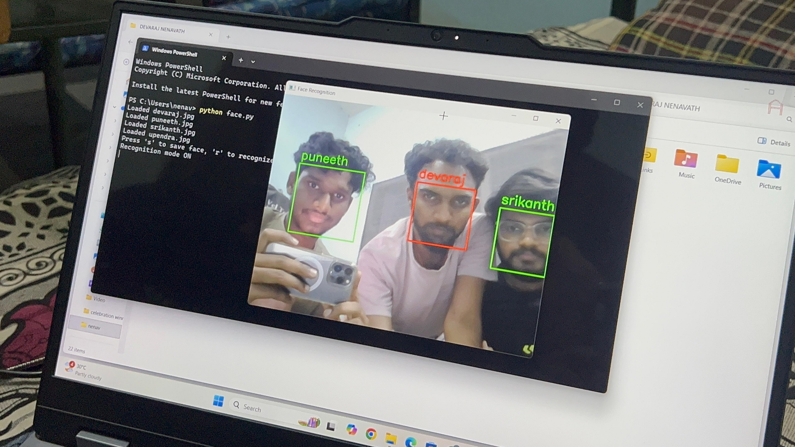
Results and Discussion

Slide 16
Conclusion with justification for SDG alignment
The proposed Smart Intrusion Disclosure Entity (SIDE) system introduces an innovative approach for real-time border surveillance in highly sensitive regions such as the Line of Control (LoC). By integrating the YOLO-based object detection algorithm with graph theory techniques, the system enhances the efficiency, accuracy, and reliability of intrusion detection compared to traditional surveillance methods. This intelligent and automated framework supports Sustainable Development Goal 16: Peace, Justice, and Strong Institutions by strengthening border security infrastructure, enabling faster threat detection, and improving institutional response mechanisms. Ultimately, the system contributes to reducing security vulnerabilities and promoting safer, more stable, and well-monitored border environments through advanced AI-driven surveillance technologies.

Slide 17
References
Bedi, G., Venayagamoorthy, G.K., Singh, R., Brooks, R.R. and Wang, K.C., “Review of internet of things (IoT) in electric power and energy systems”, IEEE Internet of Things Journal,5(2), pp.847-870, 2018. [2] He, J.,
Wei, J., Chen, K., Tang, Z., Zhou, Y. and Zhang, Y., “Multitier fog computing with large-scale iot data analytics for smart cities”. IEEE Internet of Things Journal, 5(2), pp.677-686, 2017. [3] Ngu, A.H., Gutierrez,
M., Metsis, V., Nepal, S. and Sheng, Q.Z., “IoT middleware: A survey on issues and enabling technologies”. IEEE Internet of Things Journal, 4(1), pp.1-20, 2016. [4] Shekhar, Y., Dagur,
E., Mishra, S. and Sankaranarayanan, S., “Intelligent IoT based automated irrigation system”. International Journal of Applied Engineering Research, 12(18), pp.7306-7320, 2017
P.K. and Babu, R.,“An evolutionary secure energy efficient routing protocol in internet of things”. International Journal of Intelligent Engineering and Systems, 10(3), pp.337-346, 2017.

Slide 18


